Slide 1

HOSPITAL MANAGEMENT SYSTEM
USING IoT
Done by:
NAGALAKUNTLA PRANATHI

Slide 2

ABSTRACT
The IoT-powered Hospital Management System (HMS) integrates Artificial Intelligence (AI) to enhance real-time hospital operations. By leveraging IoT sensors for continuous data collection and AI-driven analytics, the system improves patient management, resource tracking, and emergency response. Key features include real-time equipment monitoring, automated inventory tracking, and smart patient queue management. AI-based scheduling optimizes doctor availability, while predictive maintenance ensures the efficient functioning of medical equipment. This system significantly reduces patient wait times, optimizes hospital resource utilization, and enhances emergency response efficiency, creating a smart, automated, and data-driven healthcare ecosystem.

Slide 3


INTRODUCTION
The IoT-powered Hospital Management System (HMS) integrates AI and IoT to enhance healthcare efficiency. Traditional hospital management faces issues like manual scheduling, resource mismanagement, and long patient wait times. This system leverages real-time tracking, automated scheduling, and predictive analytics to optimize operations.
Key features include:
IoT-based staff & equipment tracking
AI-driven appointment & queue management
Smart resource allocation & inventory control
Automated emergency response

Slide 4


PROBLEM STATEMENT
Traditional hospital management systems suffer from inefficiencies such as manual scheduling, lack of real-time tracking, and poor resource allocation, leading to increased patient wait times and operational bottlenecks. The absence of automated monitoring and predictive analytics results in delays in patient care, inefficient staff utilization, and under- or over-utilization of hospital resources.

Slide 5
HARDWARE REQUIREMENTS
IoT Sensors & Tracking Devices.
Biometric Scanners
Wearable Health Monitors
IoT-Integrated Diagnostic Machines Communication Modules
Edge Computing Devices
Cloud Storage & AI Servers

Slide 6
SOFTWARE REQUIREMENTS
Operating System
Programming Languages
- Python, Java, Node.js for backend
- React.js, Flutter for frontend.
Database Management
AI & IoT Integration
Security & Authentication
Cloud Platforms

Slide 7
Literature Survey
More equitable and patient-centered care, considering socioeconomic factors.
Improved communication strategies and training to enhance GP-patient interactions.
Enhanced usability and user-centered design of patient guidance systems.
More accurate and efficient data analysis and risk recognition for hospital management.
Intelligent resource management solutions for hospital information systems on private clouds.

Slide 8
EXISTING SYSTEM
Traditional Hospital Management Systems (HMS) rely on manual processes, leading to inefficiencies in scheduling, resource management, and patient care.
Key limitations include:
Manual Scheduling & Tracking
Limited Real-Time Monitoring
Inefficient Emergency Response
Resource Mismanagement
No Predictive Analytics

Slide 9
PROPOSED SYSTEM
The IoT-powered AI-driven Hospital Management System enhances healthcare operations by integrating real-time tracking, automated resource management, and AI-driven analytics for smarter decision-making.
Key Features:
IoT-Enabled Tracking
AI-Driven Scheduling
Automated Emergency Handling
Smart Resource Management
Predictive Maintenance
Seamless Integration

Slide 10
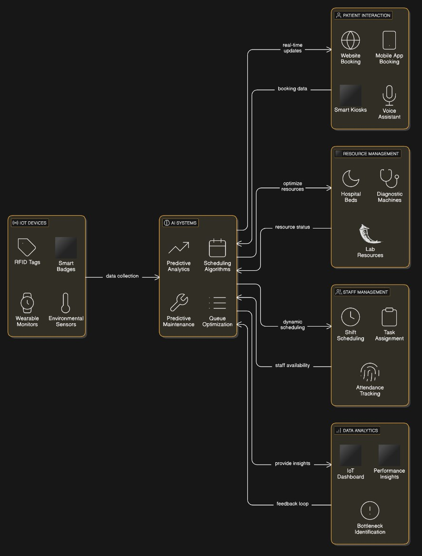
ARCHITECTURE DIAGRAM

Slide 11

MODULES
User Management Module
Appointment Scheduling Module
Patient Management Module
Real-Time Tracking Module
Queue Management Module
Resource Management Module
Emergency Handling Module
Integration Module
Data Analytics & Reporting Module

Slide 12
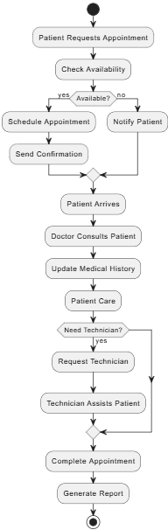

Slide 13

CONCLUSION
The IoT-powered AI-driven Hospital Management System enhances hospital efficiency, resource utilization, and patient care through real-time tracking, automated scheduling, and AI-driven analytics.
Optimized Patient Care
Smart Resource Management
Automated Workflows
AI-Driven Decision Making

